Slide 1


Solving Integer Linear Programming in Python: The Colouring Problem Case
Dec 9th , 2021
Juan D. Chacon – CSCR team Data Scientist

Slide 2
Today's Journey
An example to illustrate Branch and Bound
About Mathematical Programming & Software Development
The Graph Coloring toy problem
How to formulate it as a MILP
How to solve it using a LP modeller package
Notes:
We will walk through the details and challenges of formulating and solving integer linear programming
models using a colouring problem in python as a study case. We will discuss not just about the
mathematical nuances but how interpretability and testing play key roles while developing solutions
using this technique to tackle practical problem.

Slide 3
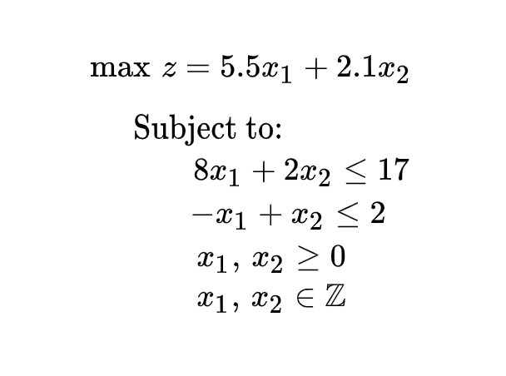
The Branch and Bound Algorithm
Let’s consider the following mix integer maximization problem.

Slide 4
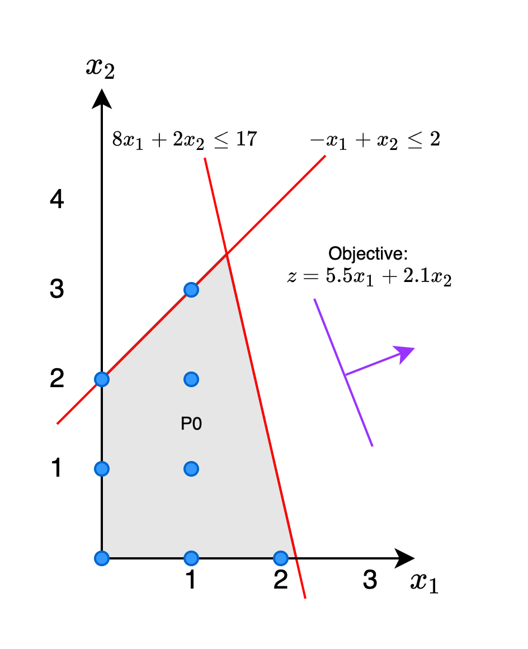
The Branch and Bound Algorithm
Let’s consider the following mix integer maximization problem.

Slide 5
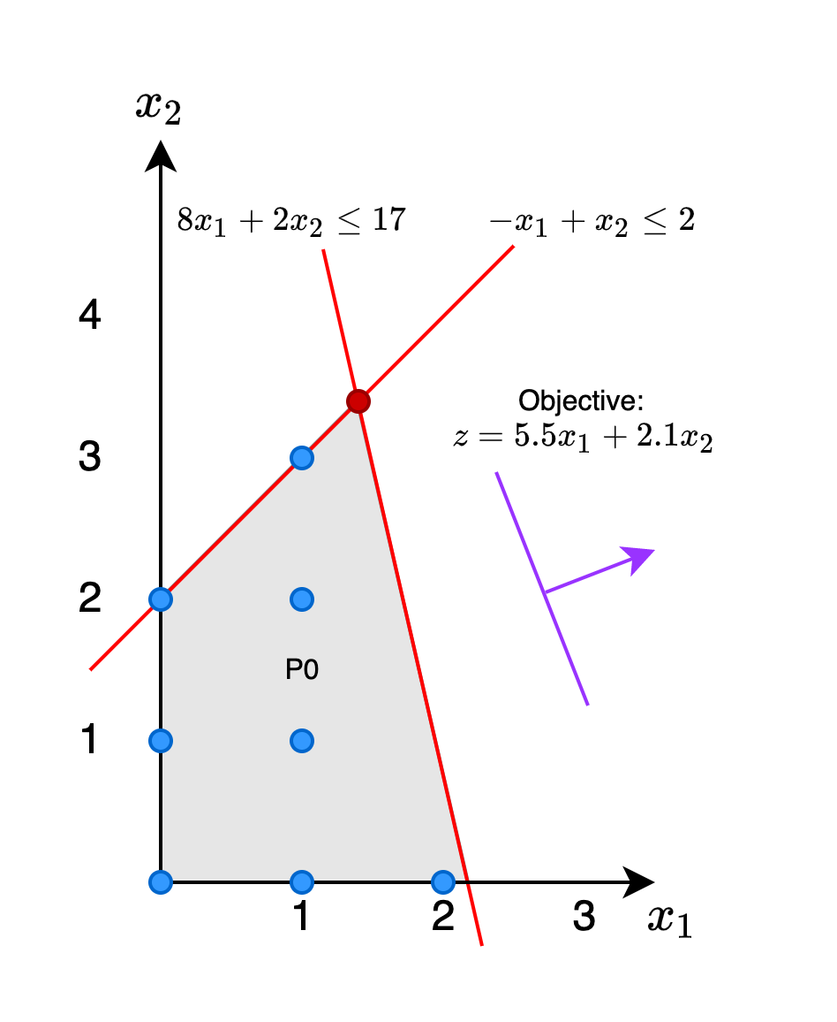
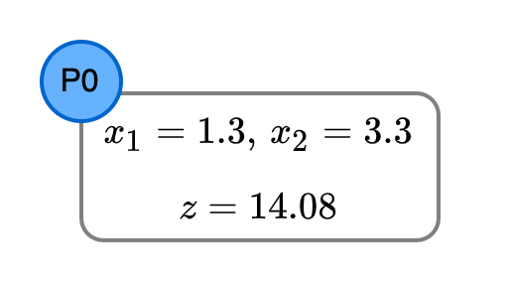
The Branch and Bound Algorithm
Let’s consider the following mix integer maximization problem.

Slide 6
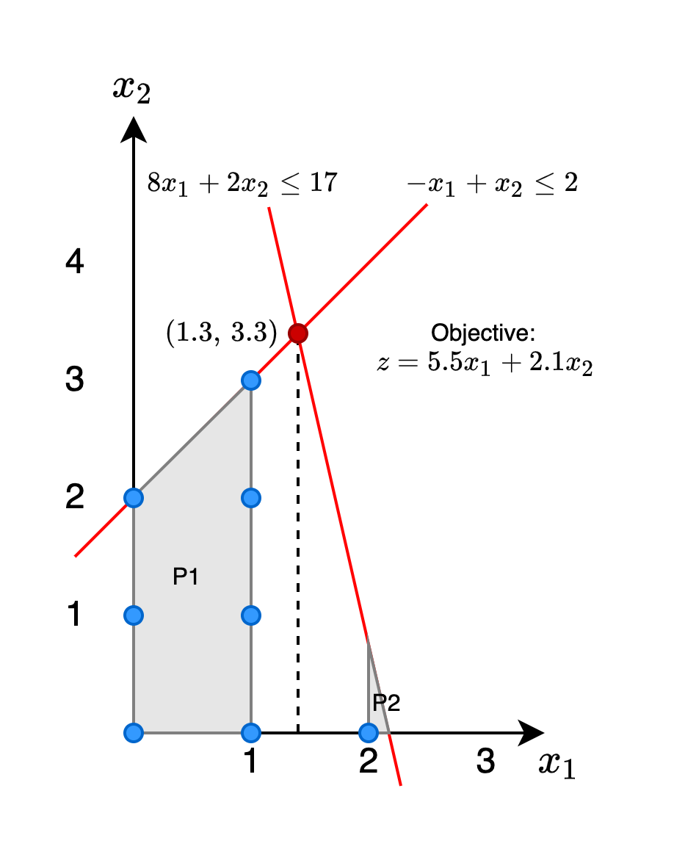
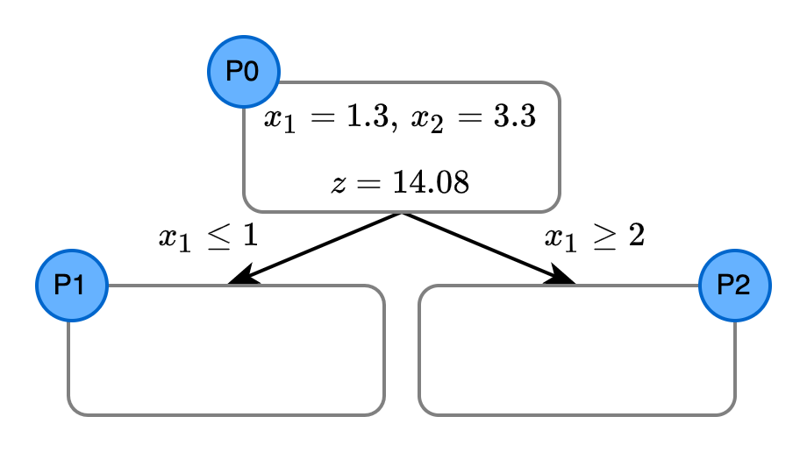
The Branch and Bound Algorithm
Let’s consider the following mix integer maximization problem.

Slide 7

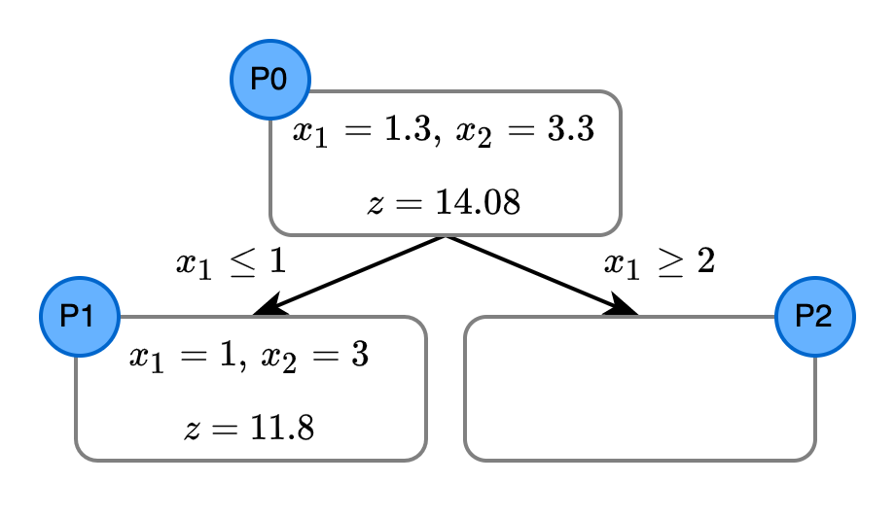
The Branch and Bound Algorithm
Let’s consider the following mix integer maximization problem.

Slide 8
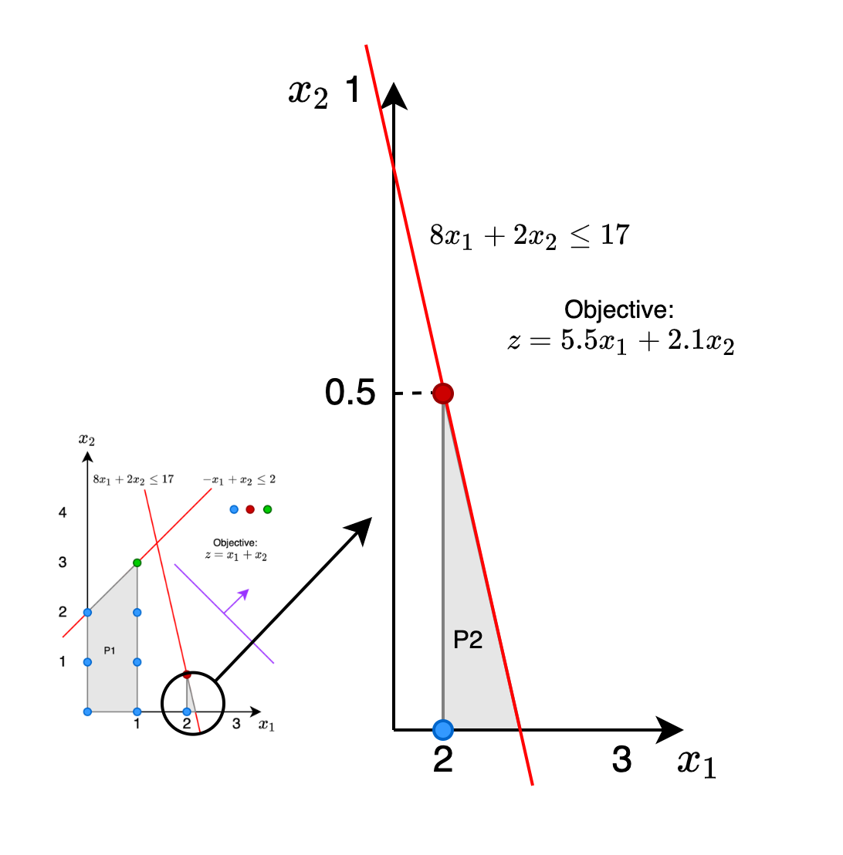
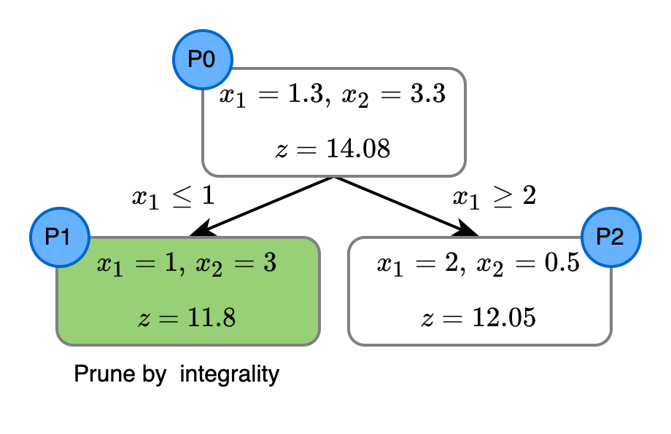
The Branch and Bound Algorithm
Let’s consider the following mix integer maximization problem.

Slide 9
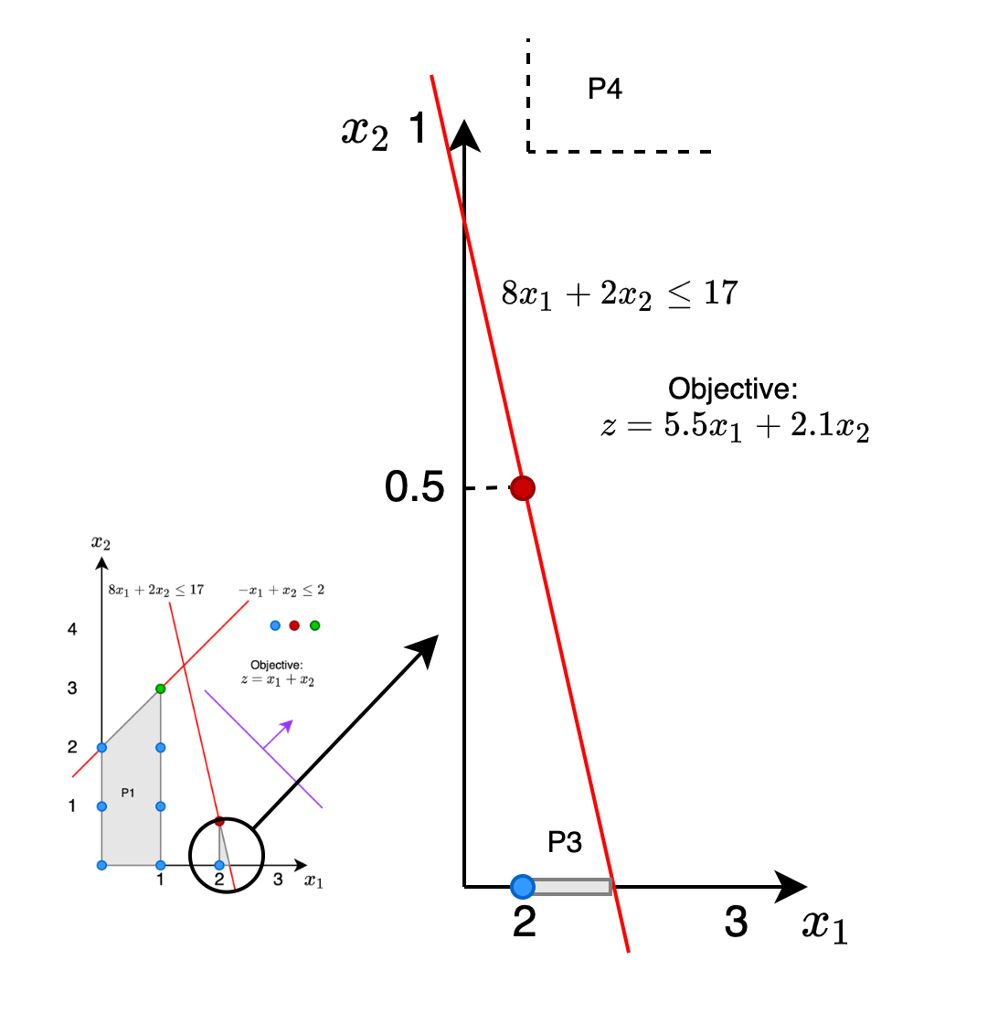
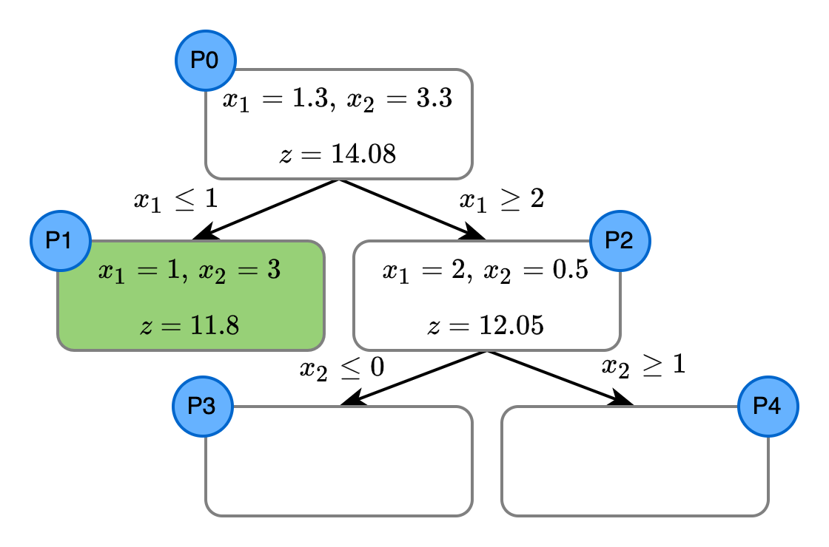
The Branch and Bound Algorithm
Let’s consider the following mix integer maximization problem.

Slide 10
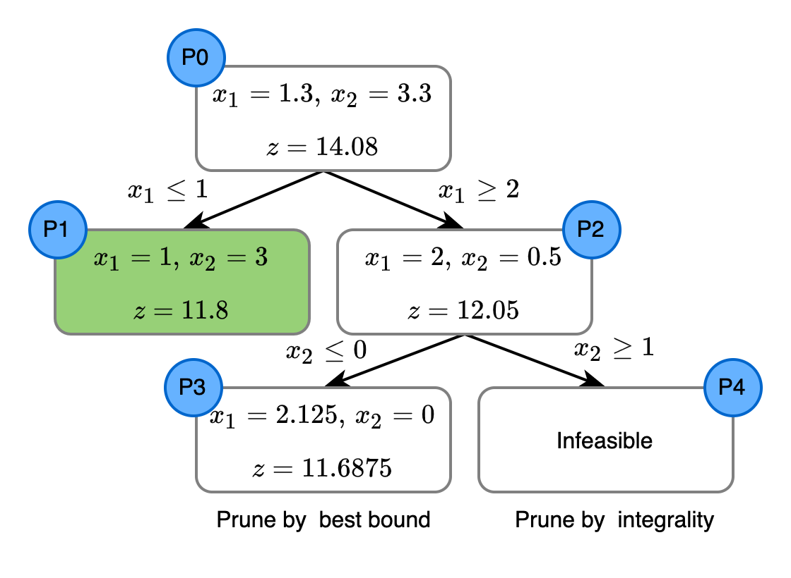
The Branch and Bound Algorithm
Let’s consider the following mix integer maximization problem.
Check it in Google Colab

Slide 11
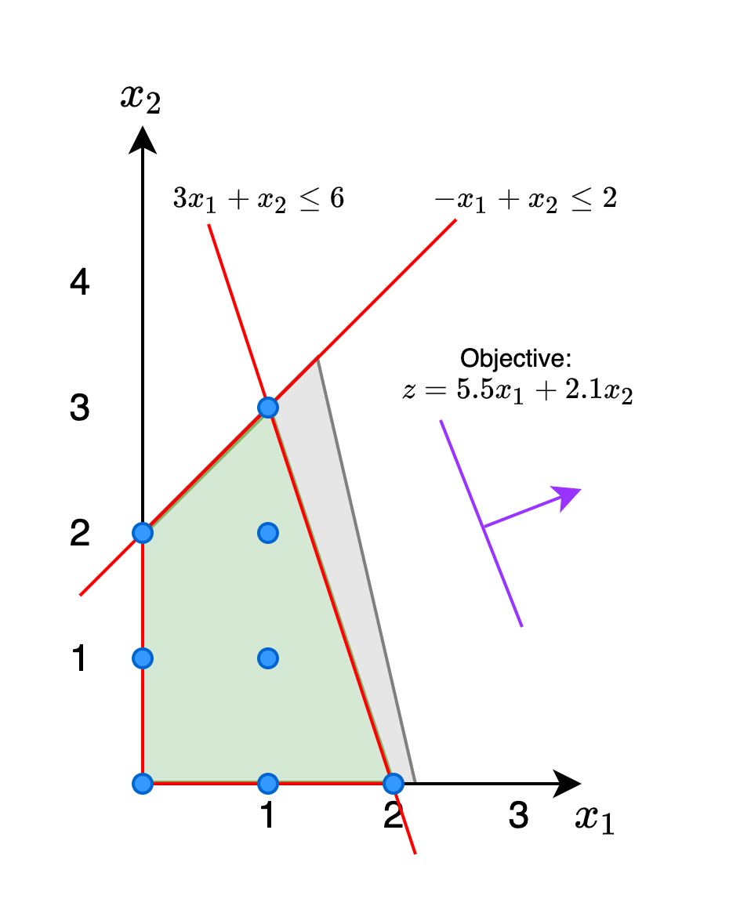
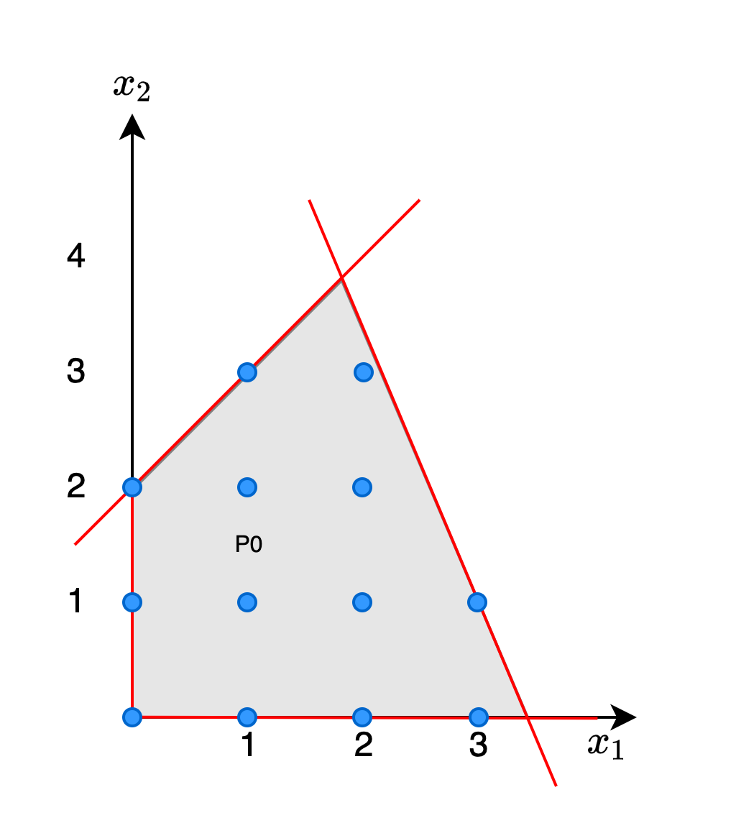
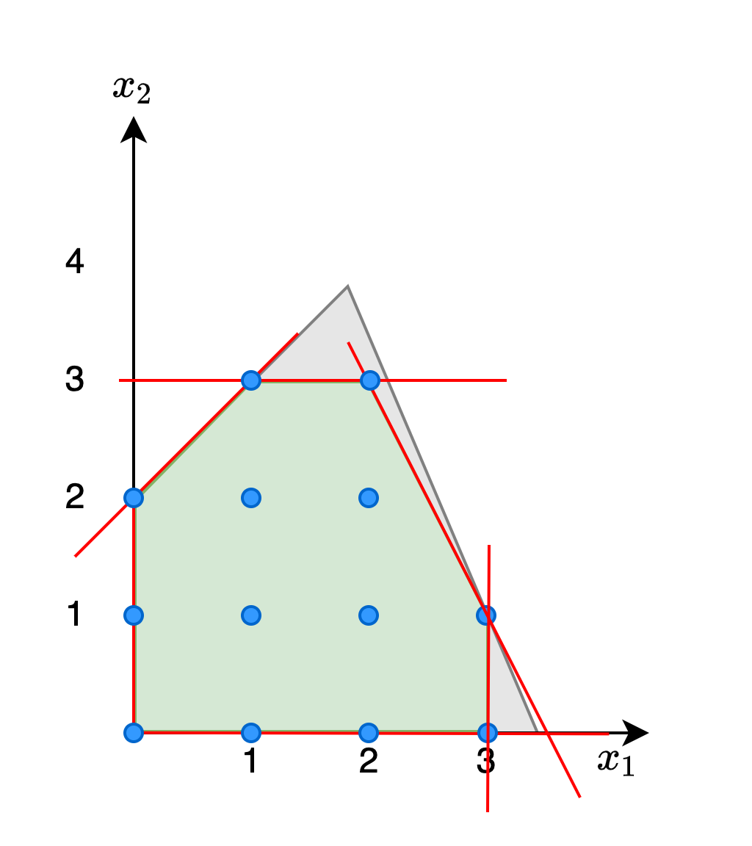
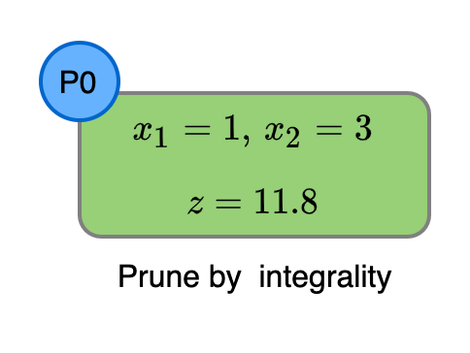
A Tighter Formulation
If we had the set of feasible integer points tighter constrained, the B&B algorithm might be faster.
However, It does not always require the same number of constraints

Slide 12
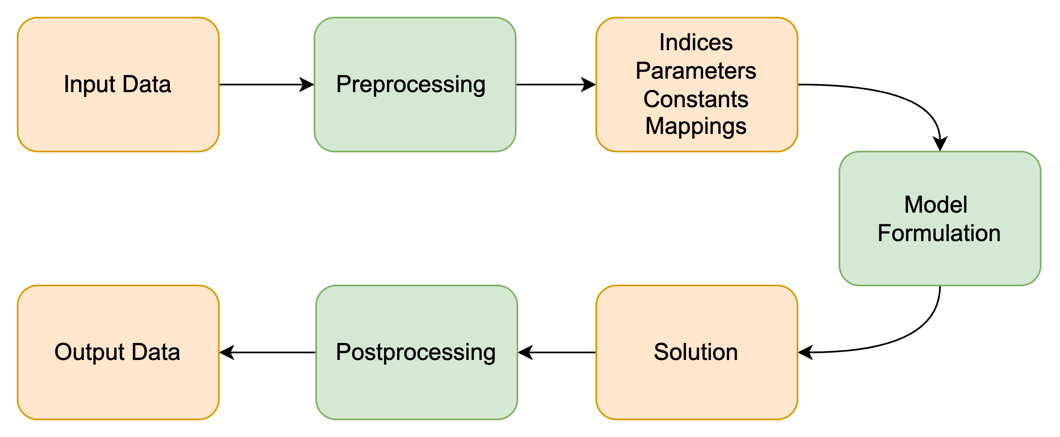
Mathematical Programming & Software Development
The Flow

Slide 13
Mathematical Programming & Software Development
The Flow

Slide 14
Mathematical Programming & Software Development
The Flow
Recommendations
1. Use optimization modeling packages to avoid the burden of working directly with matrices. It will make the model easier to formulate, interpret and debug.
2. Use object-oriented programming to keep your code clean, easy to maintain, avoid code duplication and get rid of unnecessary cognitive load. While using it keep in mind the SOLID principles.
3. Cover all your code with tests to be able to fall asleep. It is very important to find issues in the model formulation. Integration tests will work well as they cover the processing code.

Slide 15

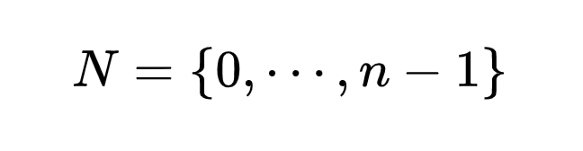
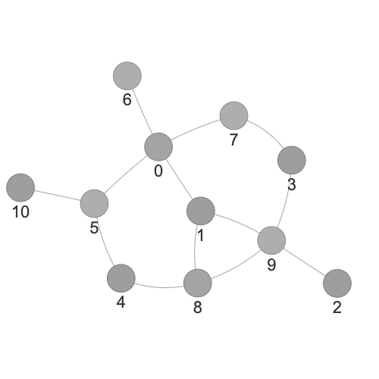
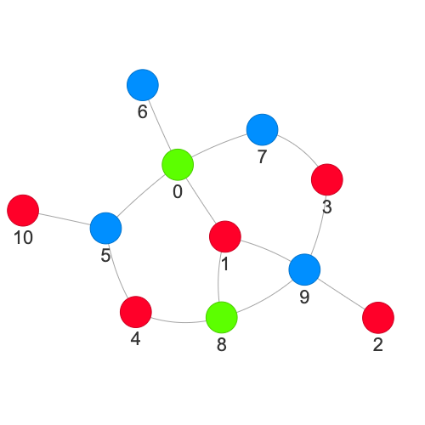
Graph Coloring Problem
Given a graph with nodes and edges $E,$find a “good” color assignation for each of the nodes, such that the number of colors is minimized.
“Good” color assignation here means no node has the same color than one of its neighbors.
Source: reddit/MapPorn

Slide 16
Graph Coloring Problem
Given a graph with nodes and edges $E,$find a “good” color assignation for each of the nodes, such that the number of colors is minimized.
Source: reddit/MapPorn

Slide 17
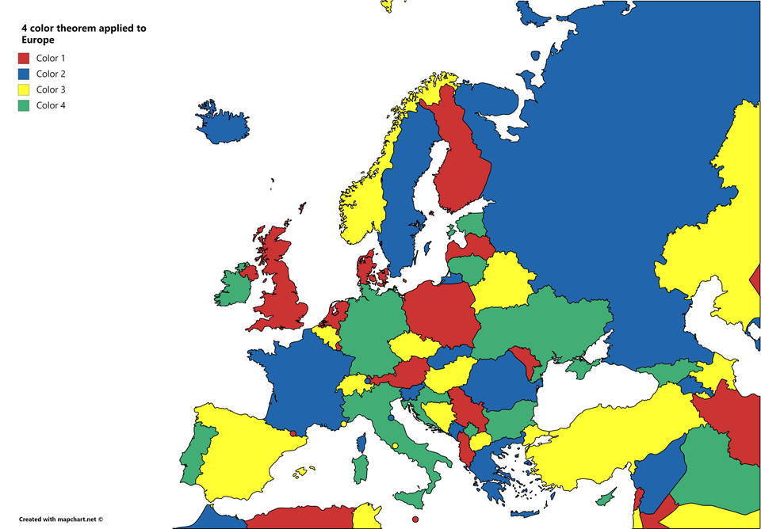
Graph Coloring Problem
Given a graph with nodes and edges $E,$find a “good” color assignation for each of the nodes, such that the number of colors is minimized.
Example
N: Countries in Europe
E: Set of
Source: reddit/MapPorn

Slide 18
Graph Coloring Problem
Given a graph with nodes and edges $E,$find a “good” color assignation for each of the nodes, such that the number of colors is minimized.
Example
N: Countries in Europe
E: Set of
Fact 1
The optimal coloring requires less than the size of the biggest neighborhood plus one
Source: reddit/MapPorn

Slide 19
Graph Coloring Problem
Given a graph with nodes and edges $E,$find a “good” color assignation for each of the nodes, such that the number of colors is minimized.
Example
N: Countries in Europe
E: Set of
Fact 1
The optimal coloring requires less than the size of the biggest neighborhood plus one
Fact 2
Every countries like map can be coloured with 4 colors
Source: reddit/MapPorn

Slide 20

Graph Coloring Problem
General Formulation

Slide 21
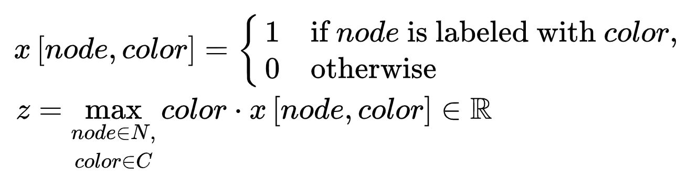

Graph Coloring Problem
General Formulation
MILP formulation
Variables
Objective

Slide 22

Graph Coloring Problem
General Formulation
MILP formulation
Variables
Objective
Constraints
Every node must be colored by only one color:

Slide 23
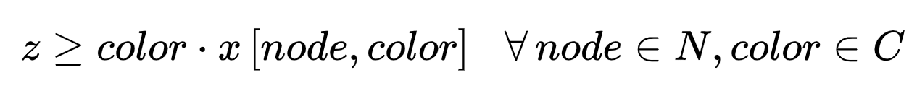
Graph Coloring Problem
General Formulation
MILP formulation
Variables
Objective
Constraints
Every node must be colored by only one color:
z matches the maximum used color:

Slide 24

Graph Coloring Problem
General Formulation
MILP formulation
Variables
Objective
Constraints
Every node must be colored by only one color:
z matches the maximum used color:
or

Slide 25
Graph Coloring Problem
General Formulation
MILP formulation
Variables
Objective
Constraints
Every node must be colored by only one color:
No neighbors share color:
z matches the maximum used color:
or

Slide 26
Graph Coloring Problem
General Formulation
MILP formulation
Variables
Objective
Constraints
Every node must be colored by only one color:
No neighbors share color:
z matches the maximum used color:
or
or

Slide 27
Graph Coloring Problem
General Formulation
MILP formulation
Variables
Objective
Constraints
Every node must be colored by only one color:
No neighbors share color:
z matches the maximum used color:
or
Incorrect!

Slide 28
Graph Coloring Using Pulp
1. Problem definition
problem = pulp.LpProblem(name="Colouring", sense=pulp.LpMinimize)

Slide 29
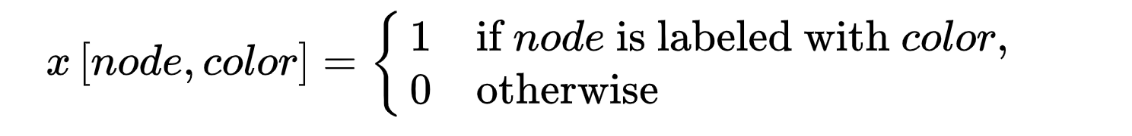
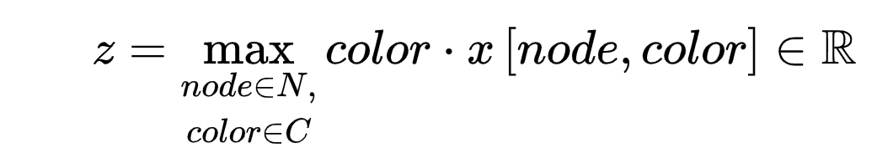
Graph Coloring Using Pulp
1. Problem definition
problem = pulp.LpProblem(name="Colouring", sense=pulp.LpMinimize)
2. Variables Definition
x = pulp.LpVariable.dicts(
name="x",
indices=product(nodes, colors),
cat=pulp.LpBinary
)
z = pulp.LpVariable(
name="z",
lowBound=0,
cat=pulp.LpCountinuous
)

Slide 30
Graph Coloring Using Pulp
1. Problem definition
problem = pulp.LpProblem(name="Colouring", sense=pulp.LpMinimize)
2. Variables Definition
x = pulp.LpVariable.dicts(
name="x",
indices=product(nodes, colors),
cat=pulp.LpBinary
)
z = pulp.LpVariable(
name="z",
lowBound=0,
cat=pulp.LpCountinuous
)
3. Objective Setting
problem.setObjective(z)

Slide 31
Graph Coloring Using Pulp
4. Constraint definition
for node in nodes:
problem.addConstraint(
pulp.lpSum(x[node, color] for color in colors) == 1,
name=f"node_has_color_{node}"
)

Slide 32
Graph Coloring Using Pulp
4. Constraint definition
for node in nodes:
problem.addConstraint(
pulp.lpSum(x[node, color] for color in colors) == 1,
name=f"node_has_color_{node}"
)

Slide 33
Graph Coloring Using Pulp
4. Constraint definition
for node in nodes:
problem.addConstraint(
pulp.lpSum(x[node, color] for color in colors) == 1,
name=f"node_has_color_{node}"
)

Slide 34
Graph Coloring Using Pulp
4. Constraint definition
for node in nodes:
problem.addConstraint(
pulp.lpSum(x[node, color] for color in colors) == 1,
name=f"node_has_color_{node}"
)

Slide 35
Graph Coloring Using Pulp
4. Constraint definition
for node in nodes:
problem.addConstraint(
pulp.lpSum(x[node, color] for color in colors) == 1,
name=f"node_has_color_{node}"
)
for node, color in product(nodes, colors):
problem.addConstraint(
z >= color * x[node, color],
name=f"obj_is_maximum_tight_{node}_{color}"
)

Slide 36
Graph Coloring Using Pulp
4. Constraint definition
for node in nodes:
problem.addConstraint(
pulp.lpSum(x[node, color] for color in colors) == 1,
name=f"node_has_color_{node}"
)
for node, color in product(nodes, colors):
problem.addConstraint(
z >= color * x[node, color],
name=f"obj_is_maximum_tight_{node}_{color}"
)
for (node1, node2), color in product(edges, colors):
problem.addConstraint(
x[node1, color] + x[node2, color] <= 1,
name=f"no_neighbors_with_same_color_{node1}_{node2}_{color}"
)

Slide 37
Graph Coloring Using Pulp
4. Constraint definition
for node in nodes:
problem.addConstraint(
pulp.lpSum(x[node, color] for color in colors) == 1,
name=f"node_has_color_{node}"
)
for node, color in product(nodes, colors):
problem.addConstraint(
z >= color * x[node, color],
name=f"obj_is_maximum_tight_{node}_{color}"
)
for (node1, node2), color in product(edges, colors):
problem.addConstraint(
x[node1, color] + x[node2, color] <= 1,
name=f"no_neighbors_with_same_color_{node1}_{node2}_{color}"
)
5. Call the solver
problem.solve(solver)

Slide 38


Graph Coloring Using Pulp
4. Constraint definition
for node in nodes:
problem.addConstraint(
pulp.lpSum(x[node, color] for color in colors) == 1,
name=f"node_has_color_{node}"
)
for node, color in product(nodes, colors):
problem.addConstraint(
z >= color * x[node, color],
name=f"obj_is_maximum_tight_{node}_{color}"
)
for (node1, node2), color in product(edges, colors):
problem.addConstraint(
x[node1, color] + x[node2, color] <= 1,
name=f"no_neighbors_with_same_color_{node1}_{node2}_{color}"
)
5. Call the solver
problem.solve(solver)
Open the git repo
Run in google colab

Slide 39
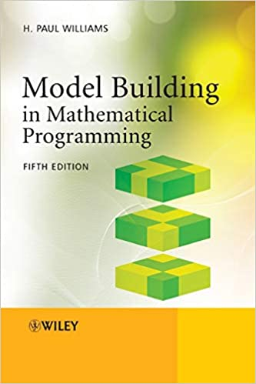
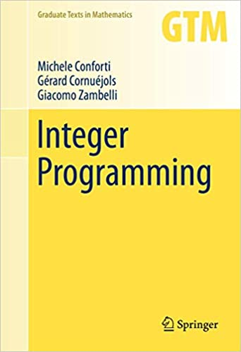

Some References
Courses and Tutorials
Mixed interger linear programing video tutorials
Discrete optimization course (Coursera) by Melbourne University
Learning Material
Model Building in Mathematical Programming 5th Edition (Paul Williams)
Integer Programming - Volume 271 - (Michele conforti)
Useful Links
COIN-OR Wikipedia
PuLP project
PuLP solvers
Interpreting CBC solver log
Interpreting Gurobi solver log
SOLID principles in python
linkedin.com/in/juan-d-chacon/

